Slide 1
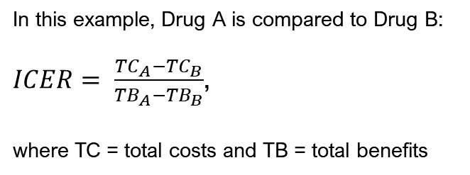
NW
NE
WTP
In this example, Drug A is compared to Drug B:
$ICER= \frac{{TC}_{A}−{TC}_{B}}{{TB}_{A}−{TB}_{B}}$,
where TC = total costs and TB = total benefits
Lowering the price of Drug A is associated with a lower ICER
SW
SE

Slide 2
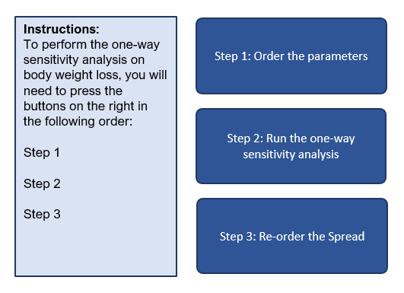
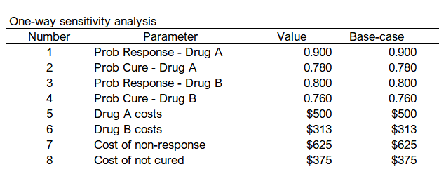
The first step is to ensure that the order in the one-way sensitivity analysis table is properly ordered according to the Parameters table.

Slide 3
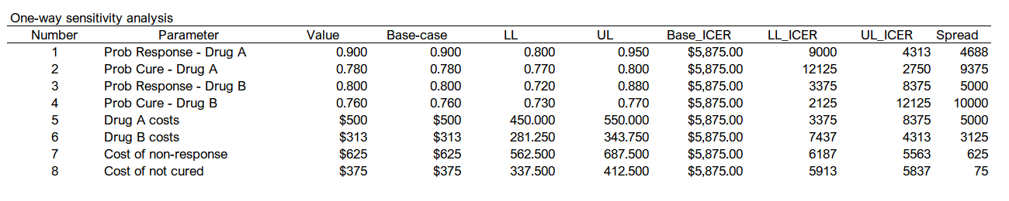
The second step runs the one-way sensitivity analysis macro. This will estimate the ICER for the lower and upper limits of the base-case parameter values.
The Spread is the absolute difference between the upper and lower results of the ICER.

Slide 4
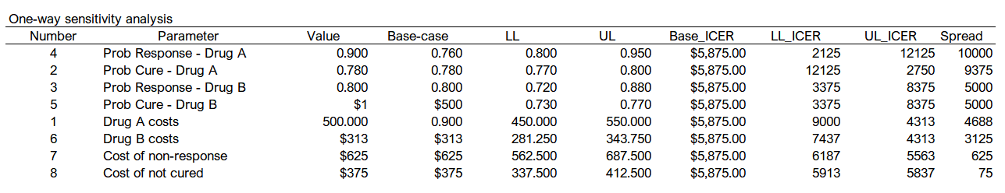
The third step re-orders the table based on the Spread in descending order.

Slide 5
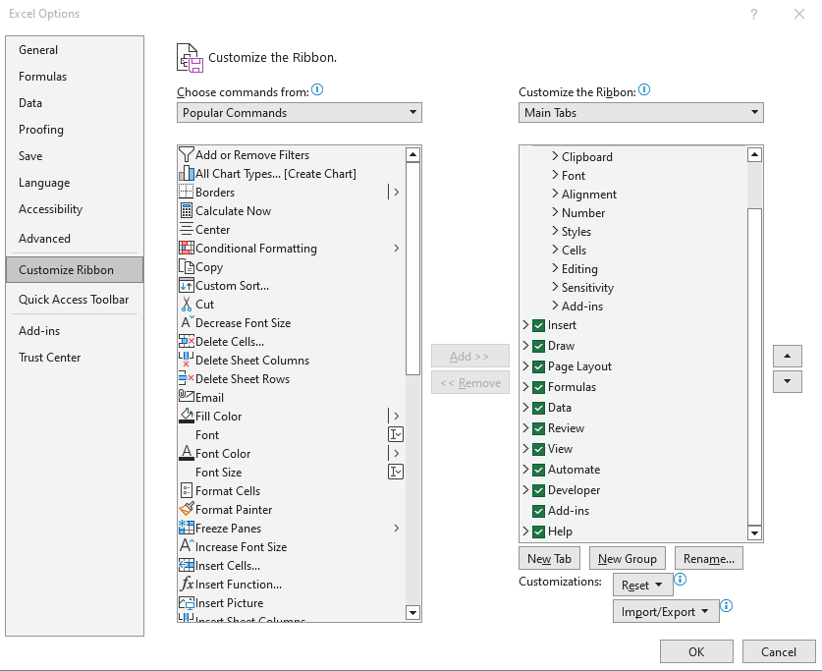
(1) Select “Customize Ribbon.”
(2) Enable the “Developer” tab

Slide 6
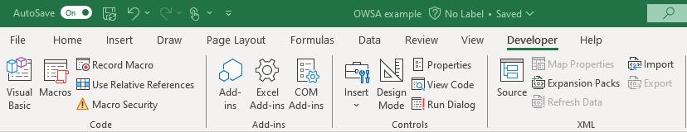
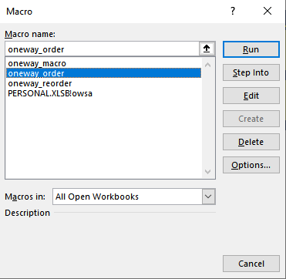
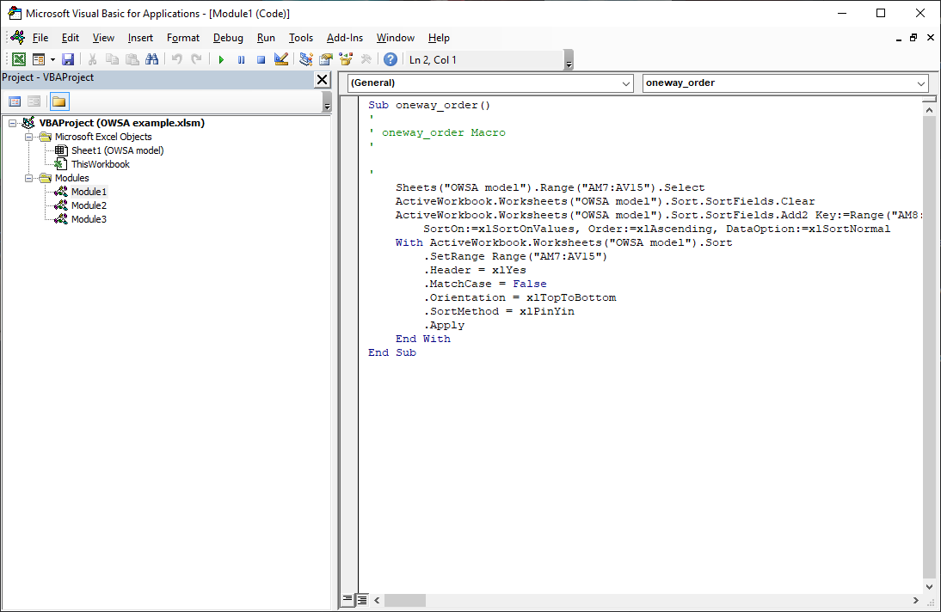
(1) Select the “Macros” icon in the Developer ribbon.
(2) This will open the “Macro” window, which contains any macro on the worksheet.
(3) Click on the “Edit” button to open the VBA editor.
Notice that there are three Modules.
We ware going to edit the “oneway_order” module

Slide 7

(2) Macro controls (Play, Pause, Stop)
(3) Name of the Macro
(1) Information about the Excel files opened and their associated macros.
Marcos are labeled as “Module 1,” “Module 2,” and “Module 3.”
There is Sheet 1 (OWSA model), which should be the Excel file that you have opened.

Slide 8
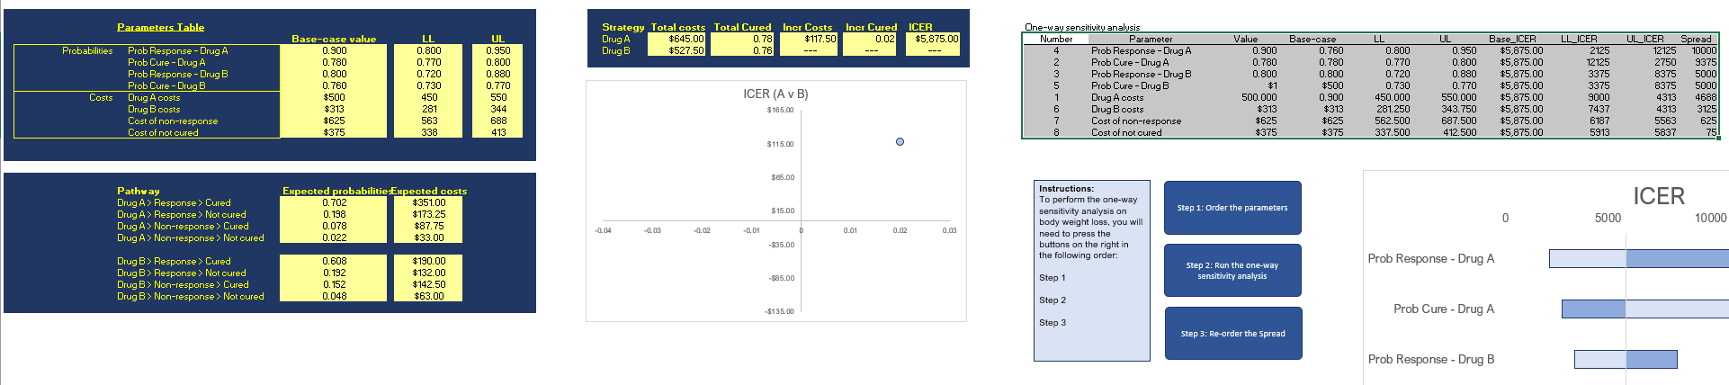
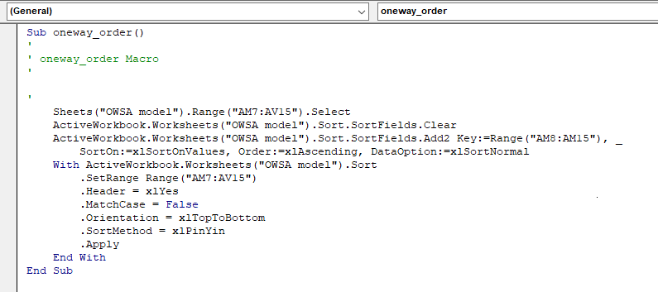
One-way sensitivity analysis table
(1) The “Sub” indicates that this is a macro in the worksheet.
It begins with “Sub” and ends with “End Sub.”
(3) The code selects the area of the one-way sensitivity analysis table on the sheet.
(2) This selects the “OWSA model” sheet
(4) The code will order the entire selected area using this column in ascending order
(5) This additional code tells the VBA macro that the first row of the selected region contains headers and to sort according to columns

Slide 9
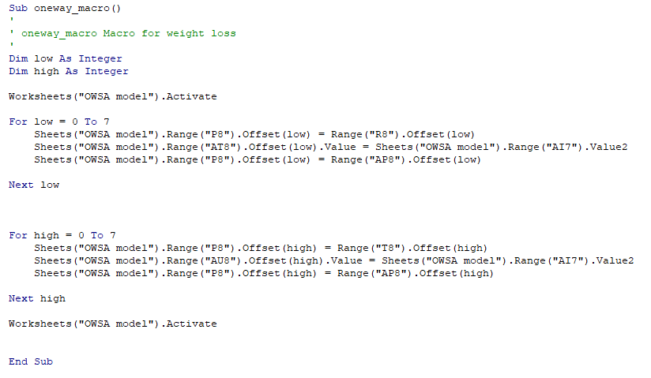
One-way sensitivity analysis table
(1) The name of this macro is “oneway_macro.”
We will use the LL and UL of the base-case values; hence, there are two iterations in this macro: “low” and “high.”
Since there are a total of 8 parameters, we will create a loop for 0 to 7 cycles.
(2) This part of the macro starts with the first value in the base-case, which is “P8”
(4) Now that “P8” is using the value from “R8” the ICER is re-calculated. The macro selects the cell at “AT8” which is the “LL_ICER” in the one-way sensitivity analysis table and makes it equal to the re-calculated ICER at cell “AI7”
(3) Next, the macro selects the value in the “LL” column, which is “R8”; this changes “P8” to the value in “R8”
(5) The last part of this iteration returns the original base-case value back to its former value. The base-case is saved in the one-way sensitivity analysis table as column “AP8:AP15”
(6) Then, this repeats for the “UL” values; hence the term “high”

Slide 10
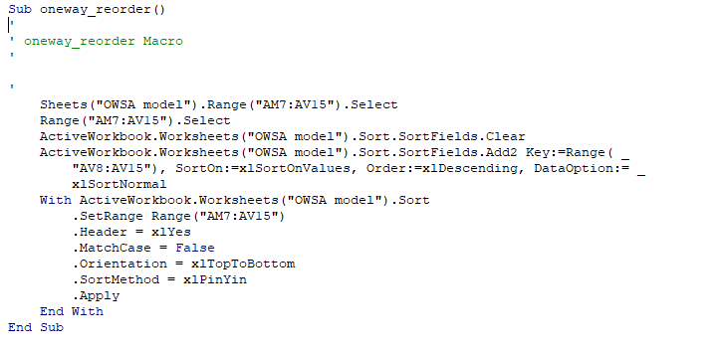
One-way sensitivity analysis table
(1) The “Sub” indicates that this is a macro in the worksheet.
It begins with “Sub” and ends with “End Sub.”
(2) This selects the “OWSA model” sheet
(3) The code selects the area of the one-way sensitivity analysis table on the sheet.
(4) The code will order the entire selected area using this column in ascending order
(5) This additional code tells the VBA macro that the first row of the selected region contains headers and to sort according to columns

Slide 11
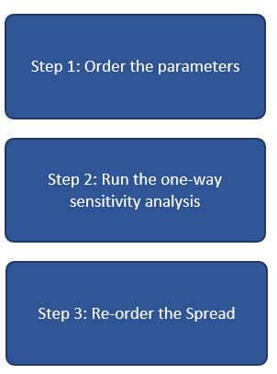
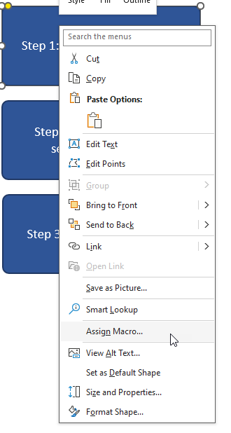
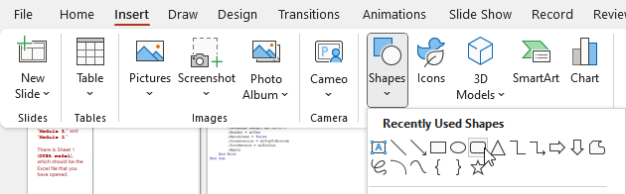
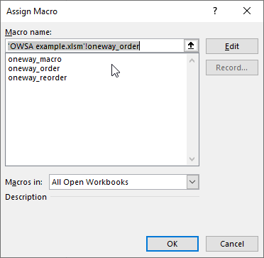
(1) Click on the Insert tab and select “Shapes” to pick the shape.
(2) Create three buttons for the three VBA macros
(4) Right-click on the button to open the options menu.
Assign the VBA macros to each button.

